Slide 1

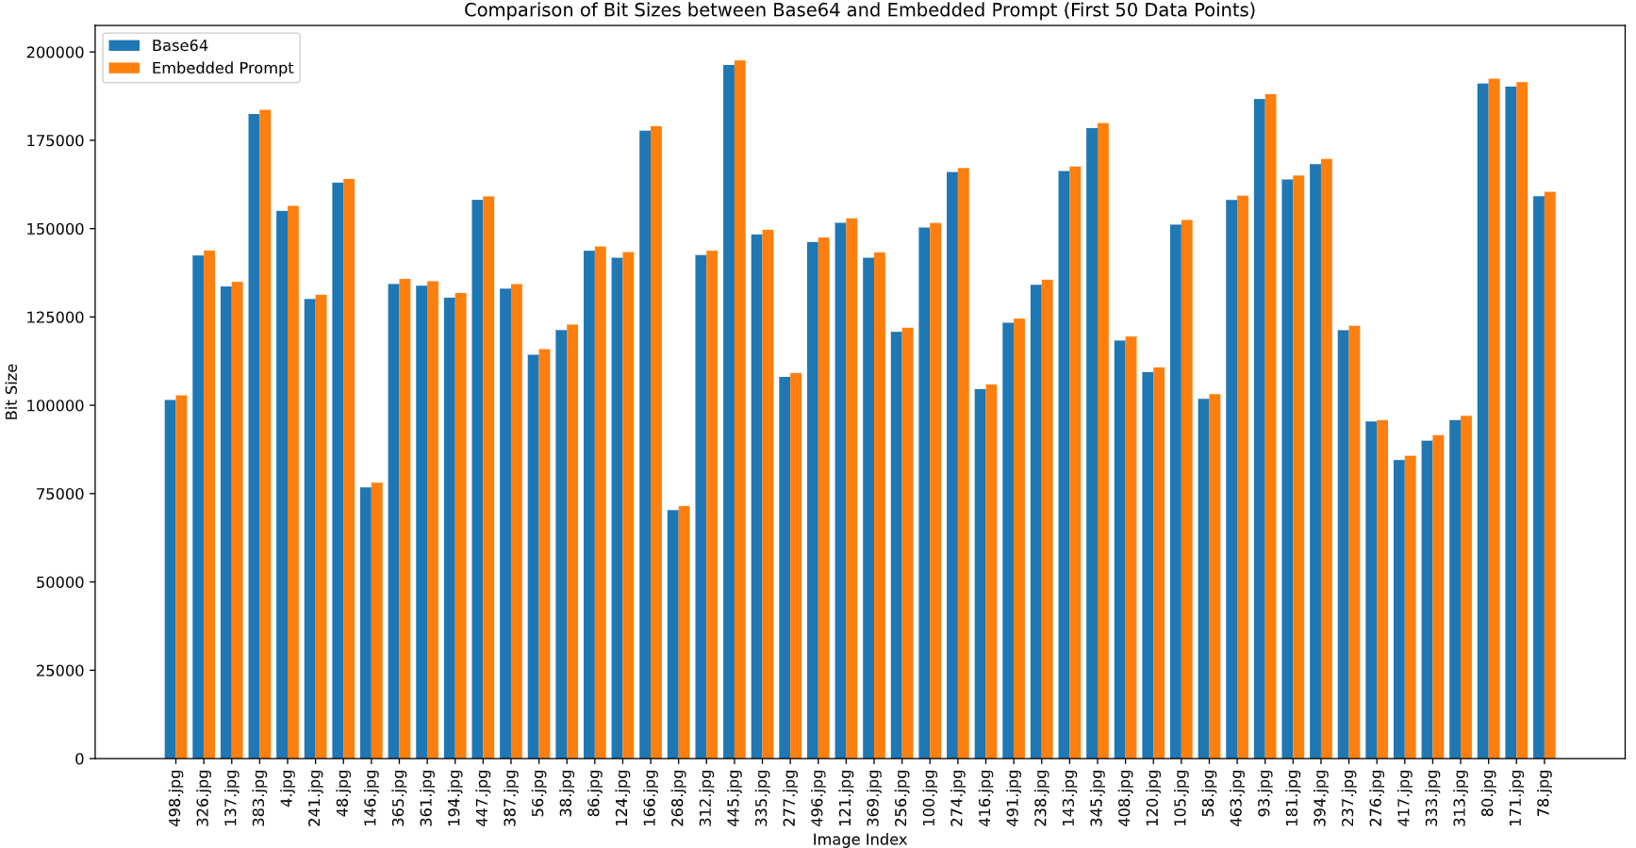
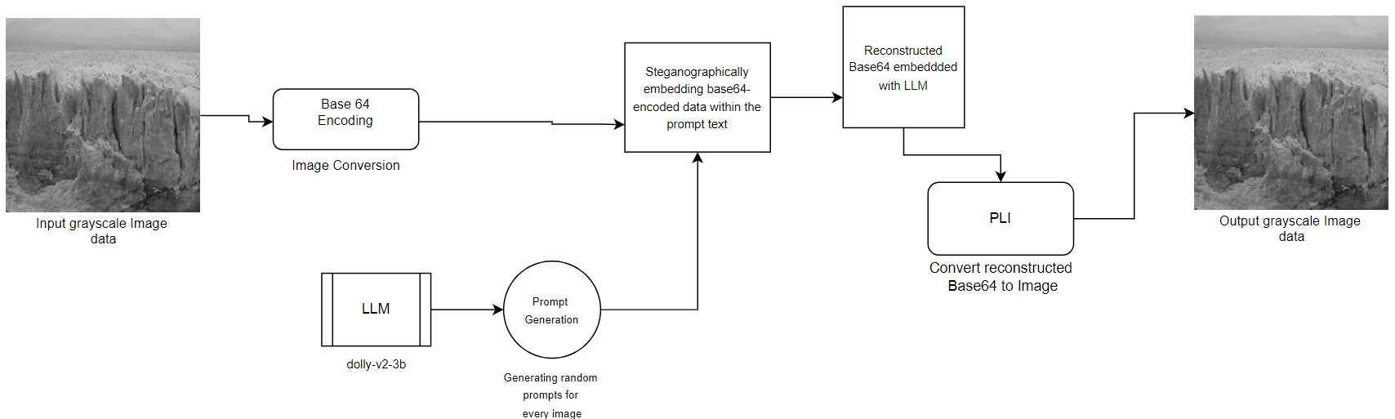
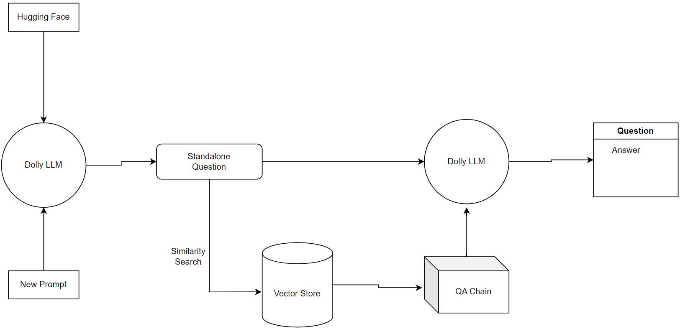
StegaText - LLM: Leveraging Large Language Models for Enhanced Text Steganography with Image Payload Encoding
Divit Patidar(dp78), Pranav Suryadevara(ps102)
ABSTRACT
The resulting output seamlessly embeds the original image information within the descriptive text generated by the language model.
The presence of any hidden data is effectively concealed from casual observers, enhancing the security of the steganographic approach.
The fine-tuning process involves training the language model on a custom dataset of image-prompt pairs, where the base64-encoded data is embedded within the prompts.
Hyperparameter tuning, validation, and iterative refinement are performed to optimize the model's performance in generating convincing and coherent prompts while effectively concealing the image data.
The final trained model is selected based on validation metrics and is ready to be deployed for generating steganographic prompts and embedding image data during the inference phase.
The steganographic approach ensures that the embedded image data remains undetectable by standard image analysis techniques, as the information is concealed within the text domain.
The language model's ability to generate diverse and contextually relevant prompts enhances the steganographic security by making it challenging to identify patterns or anomalies in the generated text.
RESULTS
Introduces an innovative LLM-based linguistic steganography technique for seamless image payload encoding in natural text.
Fine-tunes Dolly LLM to generate fluent steganographic text with controlled perturbations, ensuring data remains undetectable.
Addresses challenges of encoding images while maintaining semantic and grammatical integrity of cover text.
Leverages LLMs' language understanding for swift, effortless, and robust image concealment within text.
Advances text steganography using LLM-generated text resistant to statistical steganalysis, enabling secure communication.
The proposed steganographic approach successfully conceals image data within generated textual prompts while maintaining the coherence and naturalness of the text.
The comparison of bit sizes between the original base64-encoded images and the steganographic prompts reveals minimal overhead, demonstrating the efficiency of the proposed method in terms of data compression and storage.
BACKGROUND / MOTIVATION
Problem: Current text steganography methods lack undetectability and payload capacity and hence struggle to generate fluent covert texts that can withstand steganalysis.
Solution: To try use LLMs to develop a linguistic steganography technique that encodes image payload in natural language text while maintaining semantic and grammatical integrity.
Importance: Far-reaching implication for secure communication and data-privacy, enabling robust transmission of sensitive visual information through innocuous text channels.
Background: Traditional steganography methods face challenges in generating convincing cover texts, while advancements in LLMs offer untapped potential for linguistic steganography.
Innovation: Harness LLMs to develop cutting-edge steganography, exploring novel techniques to set new benchmarks and inspire further advancements
Comparison of the bit sizes of the base64 encoding of the image and embedded base64 encoding with the prompt.
OBSERVATIONS
The steganographic approach effectively embed base64-encoded image data withing generated text prompts, preserving data size and concealing the presence of hidden information.
The Dolly-v2-3b language model generates irrelevant and artistic textual descriptions, maintaining the steganographic nature of the embedded data.
The final output CSV file demonstrates the seamless integration of language models, image encoding, and steganographic data embedding techniques, providing a comprehensive representation of the process.
Further exploring of the language model's performance, robustness against steganalysis methods and scalability could provide insights into enhancing the steganographic quality and practical applicability of the approach.
The left part, depicts resizing of a gray-scale image, followed by a base64 conversion. Then we use the Dolly LLM to generate prompt for the image, the generated prompt and base64 are encoded together. The right part depicts the decoding of the image from this encoded string.
MODEL
We use the Dolly-v2-3b large language model from Databricks to generate descriptive textual prompts for a set of images stored in a directory.
These images have been pre-processed by converting their binary data into base64 text representations.
The language model’s role is to produce irrelevant ( for security measures ) and naturalistic descriptive captions or prompts for each image, without any prior knowledge of the actual image contents.
The model generates prompts without any prior knowledge of the image contents, maintaining the steganographic nature of the process.
The AI-generated prompts are ingeniously combined with the corresponding base64-encoded image data to achieve an intriguing form of steganography.
REFERENCES
K. Bennett. Linguistic steganography: Survey, analysis, and robustness concerns for hiding information in text. Technical report, Purdue University CERIAS Tech Report, 2004.
A. Nissar and A. H. Mir. Classification of steganalysis techniques: A study. Digital Signal Processing, 50:1–29, 2016.
Z. Li, X. Gao, J. Zhang, and Y. Zhang. Multi-label masked language modeling on zero-shot code-switched sentiment analysis. In Proceedings of the 45th International ACM SIGIR Conference on Research and Development in Information Retrieval, pages 2663–2668, 2022.
X. Shang, S. Cheng, G. Chen, Y. Zhang, L. Hu, X. Yu, G. Li, W. Zhang, and N. Yu. How far have we gone in stripped binary code understanding using large language models. arXiv preprint arXiv:2404.09836, 2024.
Architecture of the Databricks Dolly LLM.

